Slide 1



Team Project – Learning Integration Assessment
Yassine, Adam, Kee, Gio

Slide 2

Team project ideas
Team member’s name | Project Idea | Description
Yassine | Virtual Electric Circuit Builder | The application allows users to add, remove, and arrange electrical components within a workspace. Users can move components around within a closed area to create various circuit combinations.
Adam | Integrated Circuit Builder | This application allows users to arrange integrated circuits such as, Logic Gates and Microcontrollers, in various ways to create more complex computational circuits. It has a simulator that runs the circuit and gives feedback.
Kee | Chemistry Geometry Simulator | It is a simulation that can displays a 3D structure of chemical molecule according to the input of user. Users can input chemical equations and the program builds structures by following molecular geometry rules.
Gio | Particle Simulation | The application allows users to simulate particle motions under various forces, such as gravity, electric fields etc… and calculate magnitude, direction, electric fields

Slide 3
Virtual Electric Circuit Builder
Add, remove, and arrange electrical components within a workspace. Create various combinations and try different types of electrical circuits

Slide 4
CONCEPT ASPECTS
PROBLEM ADDRESSED | Most students, including ourselves, find Electricity and Magnetism to be one of the hardest, if not the hardest physics course in Cegep.
PROPOSED SOLUTION | A virtual electric circuit builder that allows users to design, simulate and test circuits using components such as resistors, power sources etc…
SOLUTION CATEGORY | Our project is an educational tool to learn about electricity, make it fun and easy. STEM Learning, mostly physics
POSSIBLE VARIABLE PARAMETERS (Circuit Components) | Users will be able to change values like voltage, resistance, capacitance, frequency etc… and see how these changes affect other parameters.
POSSIBLE VARIABLE PARAMETERS (User Interface Parameters) | Switch between different backgrounds, light mode or dark mode. Inputting variables and using the already integrated physics formulas to calculate other parameters.

Slide 5
TYPICAL INPUT
Mouse Clicks
Keyboard Keys
Click and Drag
Adjust editable inputs
Select an electrical component in a specific section of the GUI.
Once it appears in the workspace, drag it to connect it to other electrical components and make a circuit.
Adjust the electrical current intensity, electrical pressure, resistance, etc.

Slide 6
Feasibilities
Implementations using JavaFX
Border Pane (Start Window)
Upper Pane
Menu Bar
Central Pane
Border Pane (Main Window)
Upper Pane
Menu Bar
Left Pane
Scroll Pane
Pane
Right Pane
Scroll Pane
Text Field
Central Pane (Anchor Pane)
Scroll Pane (scale)
Java Canvas
Bottom Pane
HBox

Slide 7
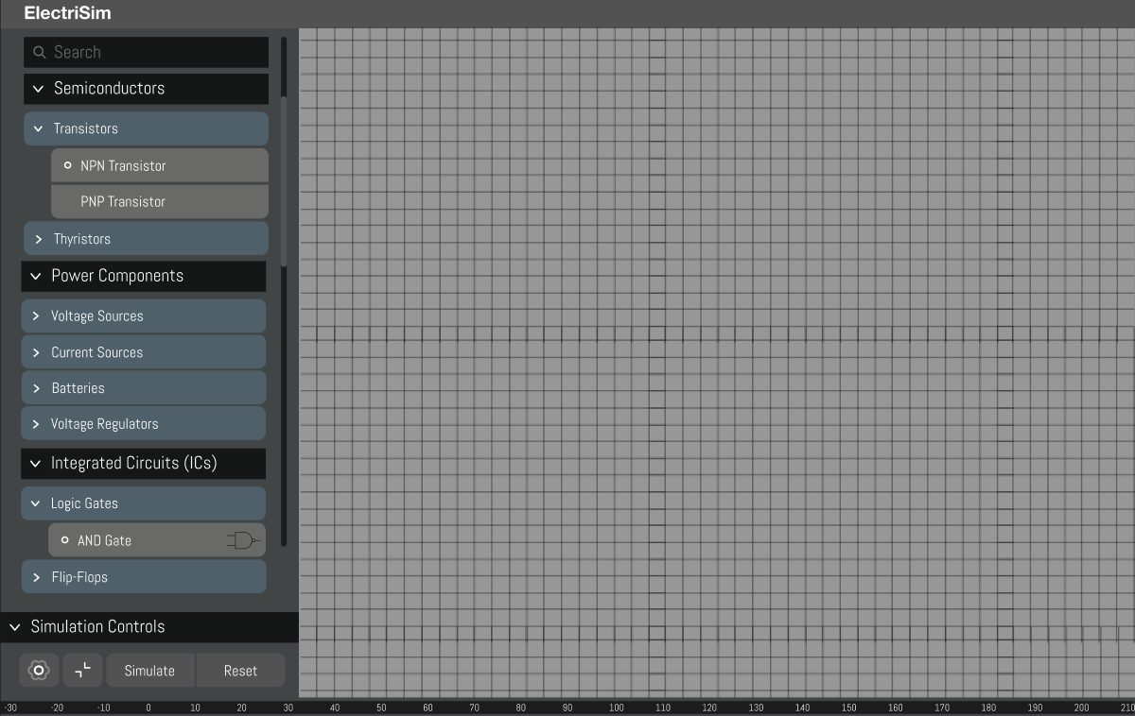
Mock Diagram

Slide 8
Explanation of Start Window
Central Pane
It makes sound when the users open the app.
There would be three buttons: Load Circuit, New Circuit, and Quit.
Load button allows users to load a saved circuit so that they can work on the project continuously.
New Circuit button allows users to make a new circuit build so that they can initialize a project.
Quit button shuts down the program.
Upper Pane (Menu Bar)
Setting menu allows user to change the preferences of the program (details will be provided later).

Slide 9
Explanation of Diagram
Menu Bar (Upper Pane)
There would be save and load feature.
Exporting the project into .json, .csv, .txt, and image (such as .png or .jpg).
Edit feature will be present.
Copy, Paste, Redo, Undo, Delete, Select All, Color and name.
Users can change the setting via setting menu on Menu Bar.
Help configuration will be on it. The configuration includes information on the components of circuit and the simulation itself.
Preference option on Setting would allow user to modify the design of the program (ex: change the background color, change between dark and bright modes. Changing of keybinding will be provided as well.
User can access to View option via the menu bar.
Maximize, minimize the graph, hide and show some of windows (such as sidebar, bottom bar, etc.)

Slide 10
Explanation of Diagram (cont)
Scroll Pane (Left Pane)
There will be a scroll menu that users can click the components of circuit that they want to add to the simulator.
This includes Transistors, Thyristors, Voltage Sources, Current Sources, etc.
Users can modify and add components of analysis graph as well.
A pane is on the bottom of the Left Pane and contains three buttons: Simulate, Node and Reset.
Simulate button starts the simulation of the circuit that is made by users.
Node button adds Sim Node.
Reset button reset the current circuit on the builder.

Slide 11
Explanation of Diagram (cont)
Scroll Pane (Right Pane)
Parameters would be provided as Collapsible Table on scroll menu. Users can open and close parameters depends on the situation and preference.
This includes the status of outputs (such as light bulb), resistors, battery, etc.
Users can change the color of the components here.
A Text Field provides the information needed in order to the users to fix the circuit. For example, if there is shortage of voltage, the Text Field would response “Not Enough Voltage”.
HBox (Bottom Pane)
Includes the graphs and its parameter that are added by users.

Slide 12
Explanation of Diagram (cont)
Central Pane (Scroll Pane)
The Scroll Pane on the Central Pane is set as changing scale which means that users can change the scale of the within the Scroll Pane. This functionality would support users to zoom in and out the program when they want to do so.
Within the Scroll Pane, there is JavaFX Canvas Pane. The Canvas Pane draws some grid lines to help users to connect and place components of circuit and estimate the size of it.
The size of the grid line is dependent on the scale of Scroll Pane. Zooming in makes the grid bigger, zooming out makes the grid smaller.
On JavaFX Canvas, users can drag and place the components of circuit as they want to. This is the core functionality of the program, allowing users to make a diagram of a circuit and simulating it. When two components are connected (for example, a bulb and wire), the program detects it and snaps two components so that the circuit can be formed.

Slide 13

Individual Parts
Yassine
Adam
Kee
Gio
Start Simulation
Circuit builder
Snap components to each other
Circuit logic
Start Window
Loading sound
Load menu
New menu
Name sim
Quit
File submenu
Close
Settings submenu
Help
Components
Simulation
Components groups, subgroups, names, and diagram
Editable text boxes
Components parameters
Load simulation
Starting new simulation function
save /save and quit/ export
Add sim node
Analysis Graph (using nodes)
Feedback label
Edit
Undo - Redo
Copy - Paste
Delete - Select All
Color - Name
Preferences
Background changes
View
Maximize/Minimize graph
Reset simulation

Slide 14
THANKS!

Slide 15
Menu bar (for sim)
File
Close
Save
Save and quit
export
JSON
CSV
Text
Image
Edit
Undo - Redo - Copy
Paste - Delete - Select All
Color - Name
Settings
Help
Components
Simulation
Preferences
Background
Dark/Light mode
Keybinds
View
Maximize/Minimize graph
Simulation
Components
Components group
Components subgroup
Components
name
diagram
Text box
Sim Controls
Simulate
Reset sim
Garbage
redo / undo
Add sim node
Analysis Graph
Feedback
Circuit builder
Snap components to each other
Circuit logic
Parameters
Label
Color
Component diagrams/maximums
Start Menu
Loading sound
Load menu button
New menu button
Quit
Load menu
Load sim#
Quit
New menu
Name sim
Start button
Menu bar (start menu)
File
Close
Settings
Help
Preferences
Background
Design
Component Images
Logo
Audio

